Slide 1



Making Health Economics Shiny: A tutorial
Robert Smith & Paul Schneider
ScHARR, University of Sheffield

Slide 2



Who we are
Robert Smith
Paul Schneider

Slide 3

Tutorial Information
Open Access Content Available here: https://robertasmith.github.io/healthecon_shiny/
Including:
Academic Paper
Tutorial
App code

Slide 4
Prerequisite knowledge
R programming:
Functions
Objects
Loops
Packages
Plotting
Health economics:
Markov Model
QALYs
ICERs
PSA
Cost-effectiveness Plane
CEAC

Slide 5

Background

Slide 6

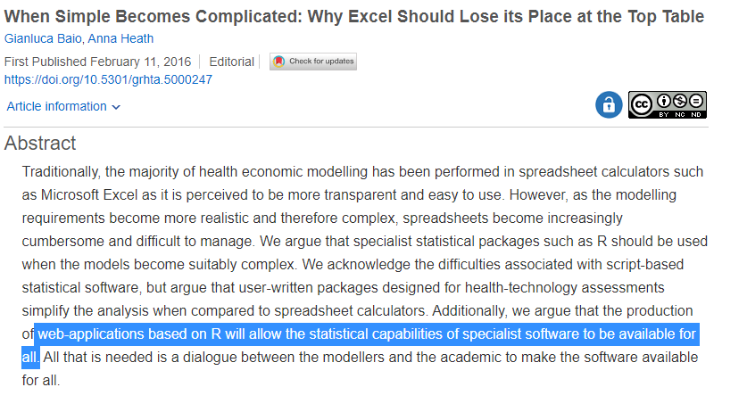
Background
“The future of cost-effectiveness modelling lies in web-apps, in which graphical interfaces are used to run script-based models”

Slide 7
Current Process
Input
Model
Output
Plots
Present

Slide 8
Future process?
Input
Model
Output
Plots
Present

Slide 9
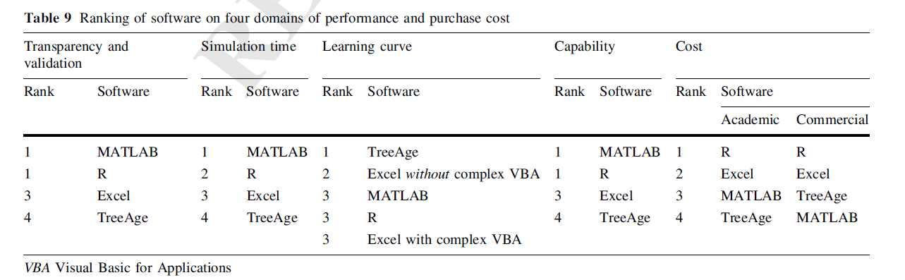
R for Decision Modelling?
Hollman, C., Paulden, M., Pechlivanoglou, P. and McCabe, C., 2017. A comparison of four software programs for implementing decision analytic cost-effectiveness models. Pharmacoeconomics, 35(8), pp.817-830.

Slide 10



Teaching and Tutorials

Slide 11


Who is teaching what?
Input
Model
Output
Plots
Present

Slide 12
Examples

Slide 13
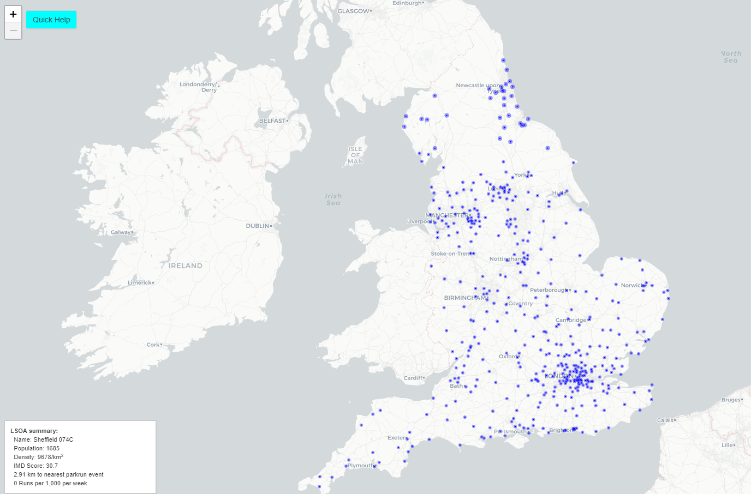
Where should parkrun locate new events?
http://iol-map.shef.ac.uk/

Slide 14

World Health Organization - FGM Model
https://srhr.org/fgmcost/

Slide 15
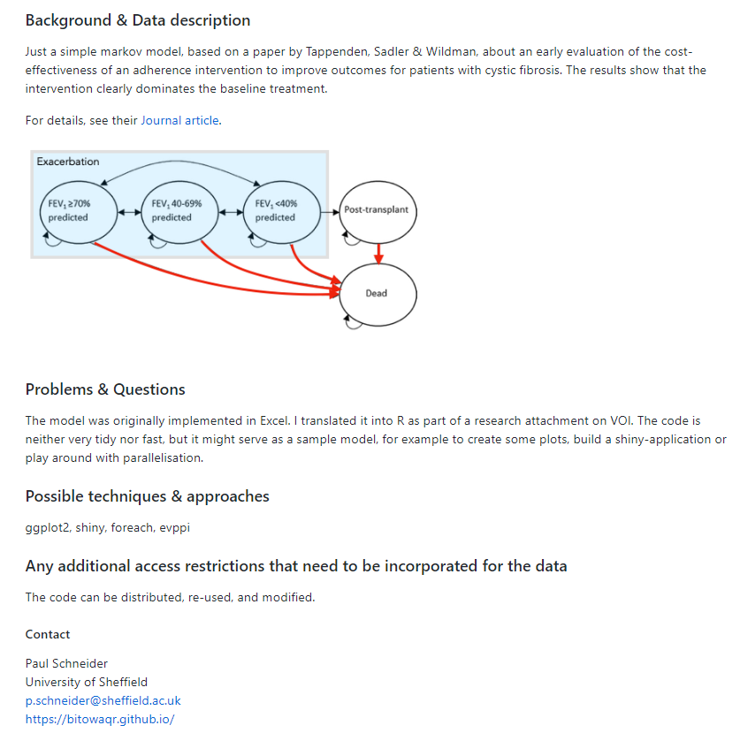

Cystic Fibrosis Adherence
https://github.com/HealthEconomicsDataDive/shiny_s5

Slide 16
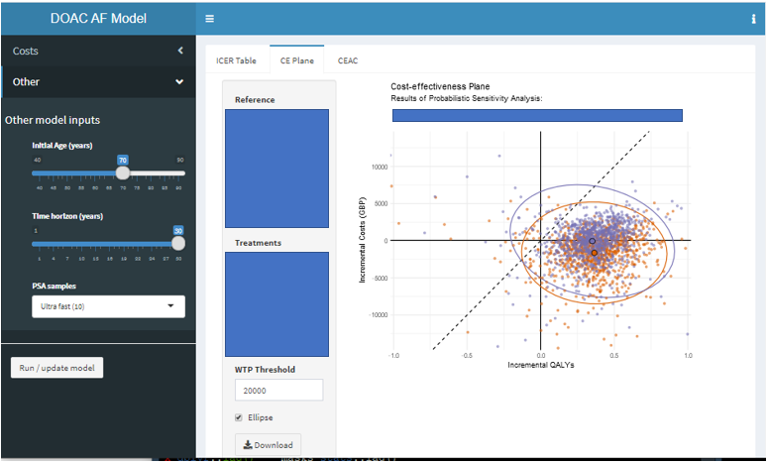
Health Technology Assessment

Slide 17
Tutorial

Slide 18
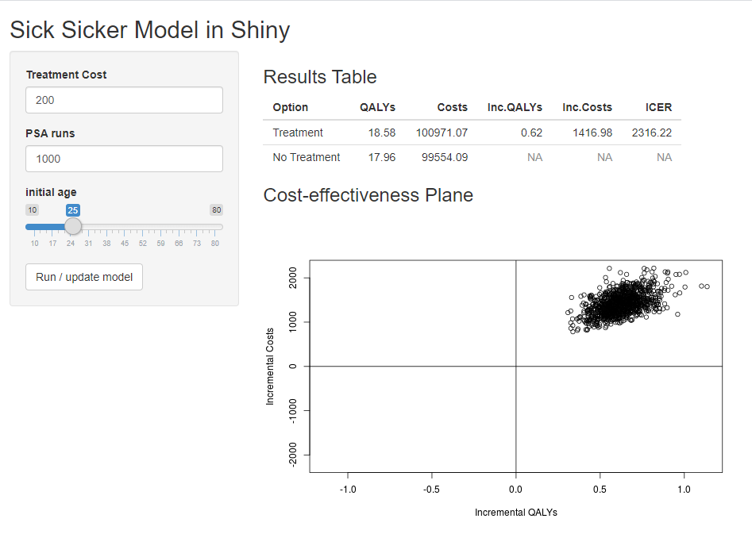
Simple App
https://robertasmith.shinyapps.io/sick_sicker/

Slide 19
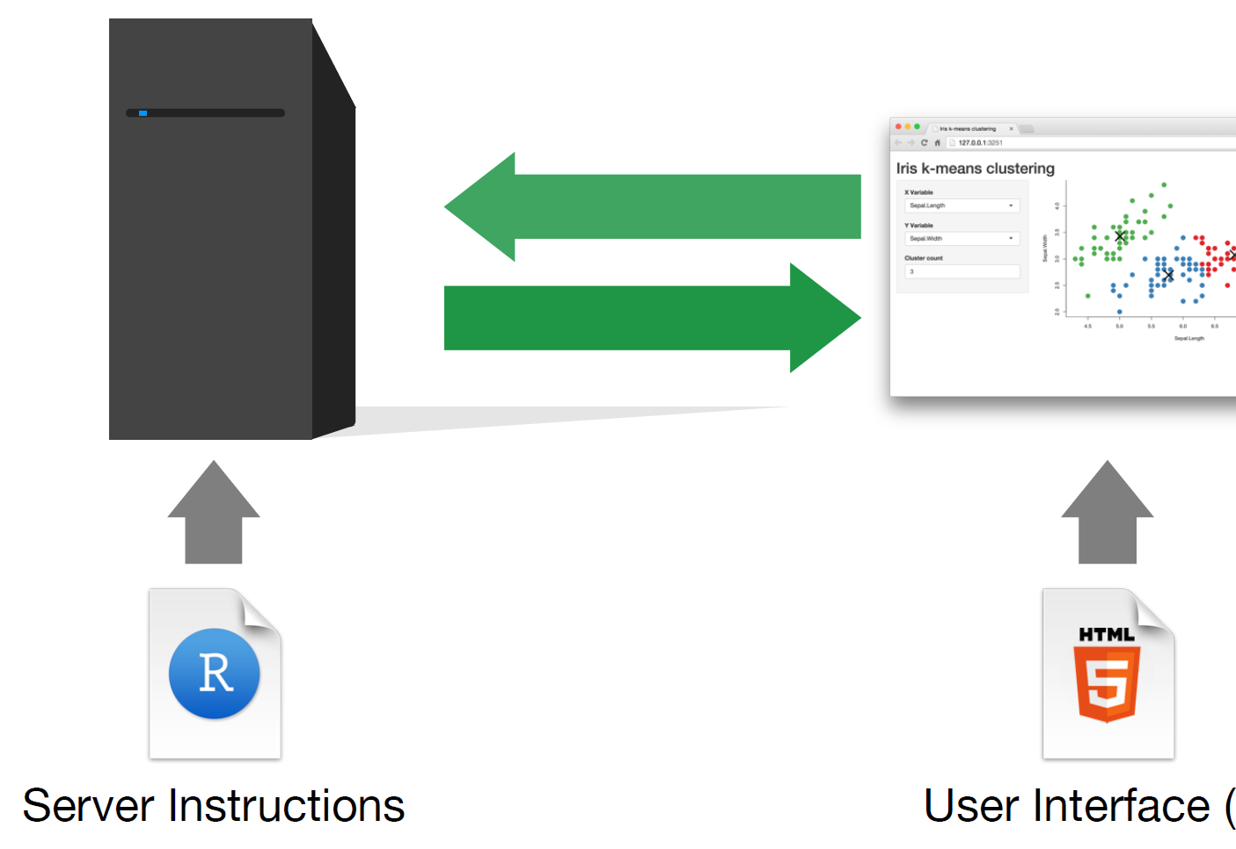
How does Shiny work?

Slide 20
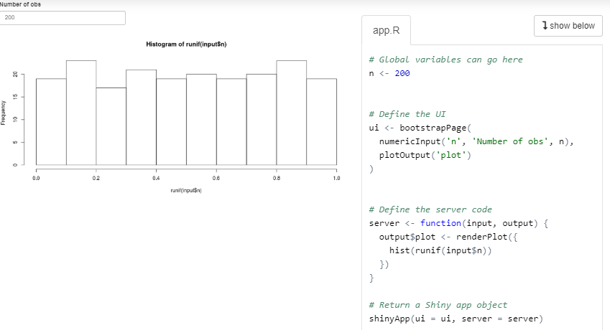
Simple shiny application
https://shiny.rstudio.com/gallery/single-file-shiny-app.html

Slide 21
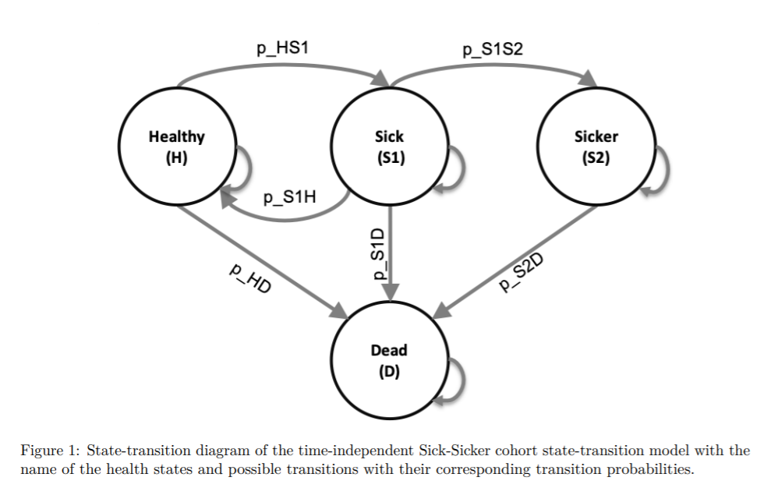
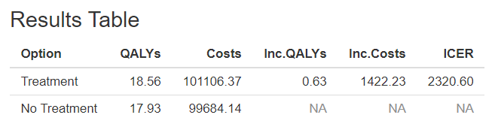
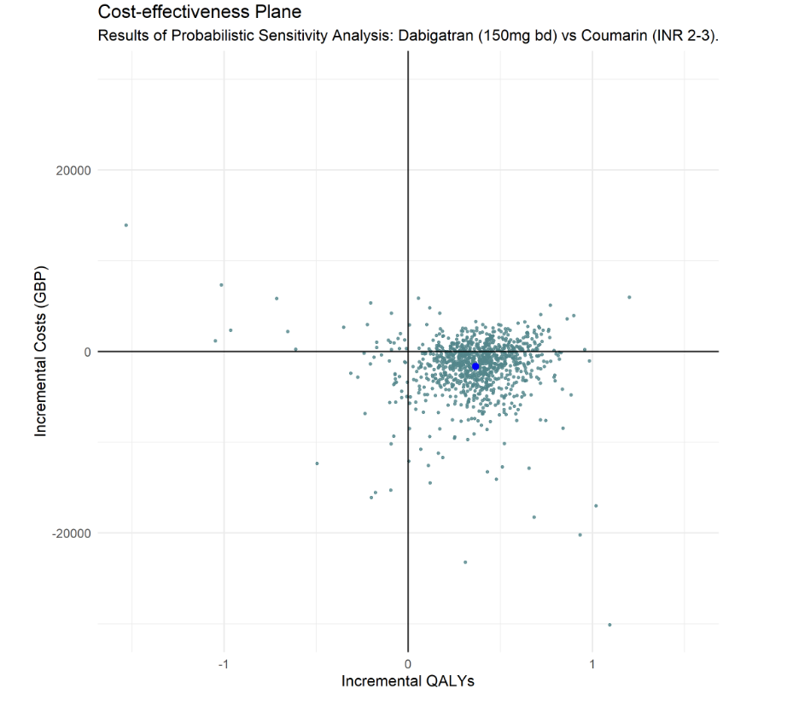
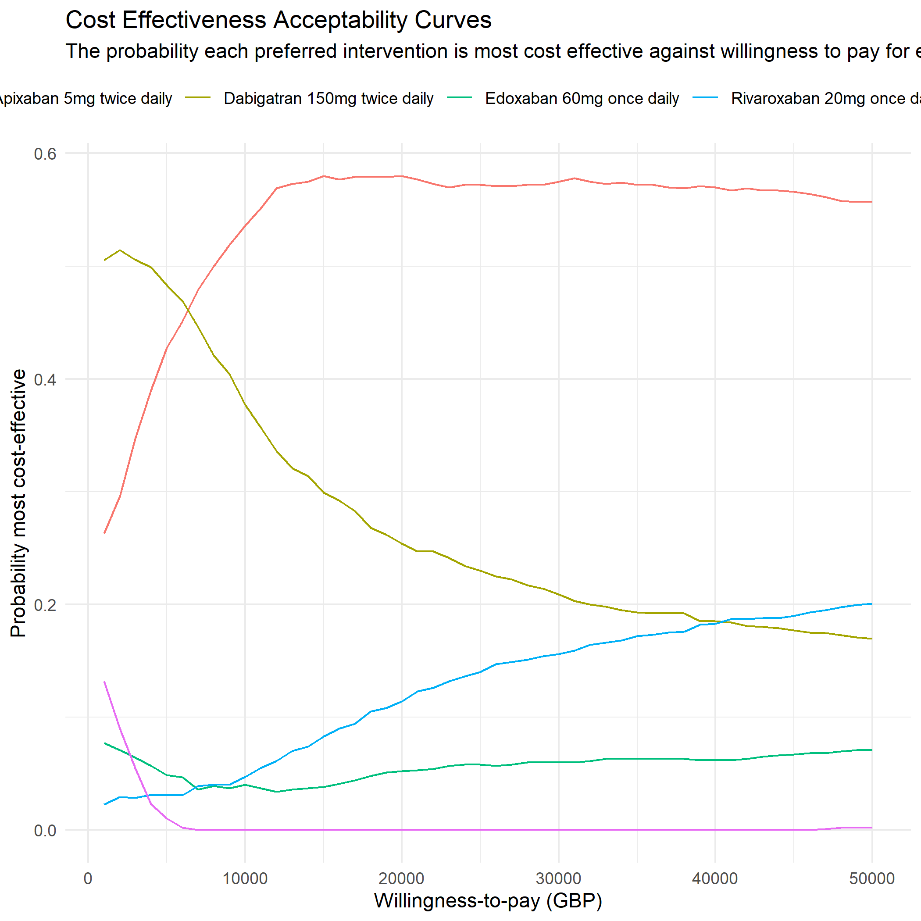
Inputs
Cost-effectiveness model in R
Function
Outputs
Parameters
c_s1 | cost1 | 3
c_s2 | cost2 | 5
c_H | cost3 | 6
dr | Dis_rate | 0.035
n_sim | No. psa | 1000

Slide 22
Steps
1. Understanding the model inputs and outputs.
2. Wrapping the model into a function.
3. Creating the app (iteratively adjusting user interface & server)
4. Deploying the app

Slide 23

Understanding the model inputs and outputs

Slide 24
DARTH Sick Sicker Model
https://github.com/RobertASmith/healthecon_shiny/tree/master/Tutorial

Slide 25

Wrapping the model into a function

Slide 26

Wrapping the model into a function

Slide 27
Inputs
Function
Outputs
Parameters
c_s1 | cost1 | 3
c_s2 | cost2 | 5
c_H | cost3 | 6
dr | Dis_rate | 0.035
n_sim | No. psa | 1000

Slide 28
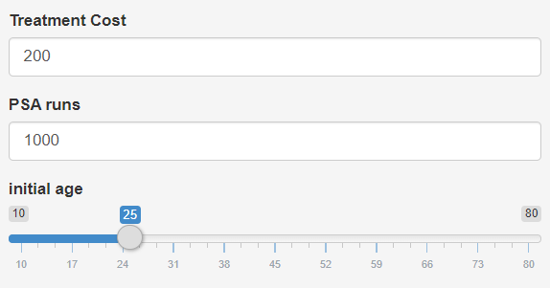
Inputs
Cost-effectiveness model in R-shiny
Function
Outputs
Parameters
c_s1 | cost1 | 3
c_s2 | cost2 | 5
c_H | cost3 | 6
dr | Dis_rate | 0.035
n_sim | No. psa | 1000

Slide 29

Creating the app

Slide 30

User Interface
Server
https://github.com/RobertASmith/healthecon_shiny/blob/master/App/app.R

Slide 31

Deploying the app

Slide 32
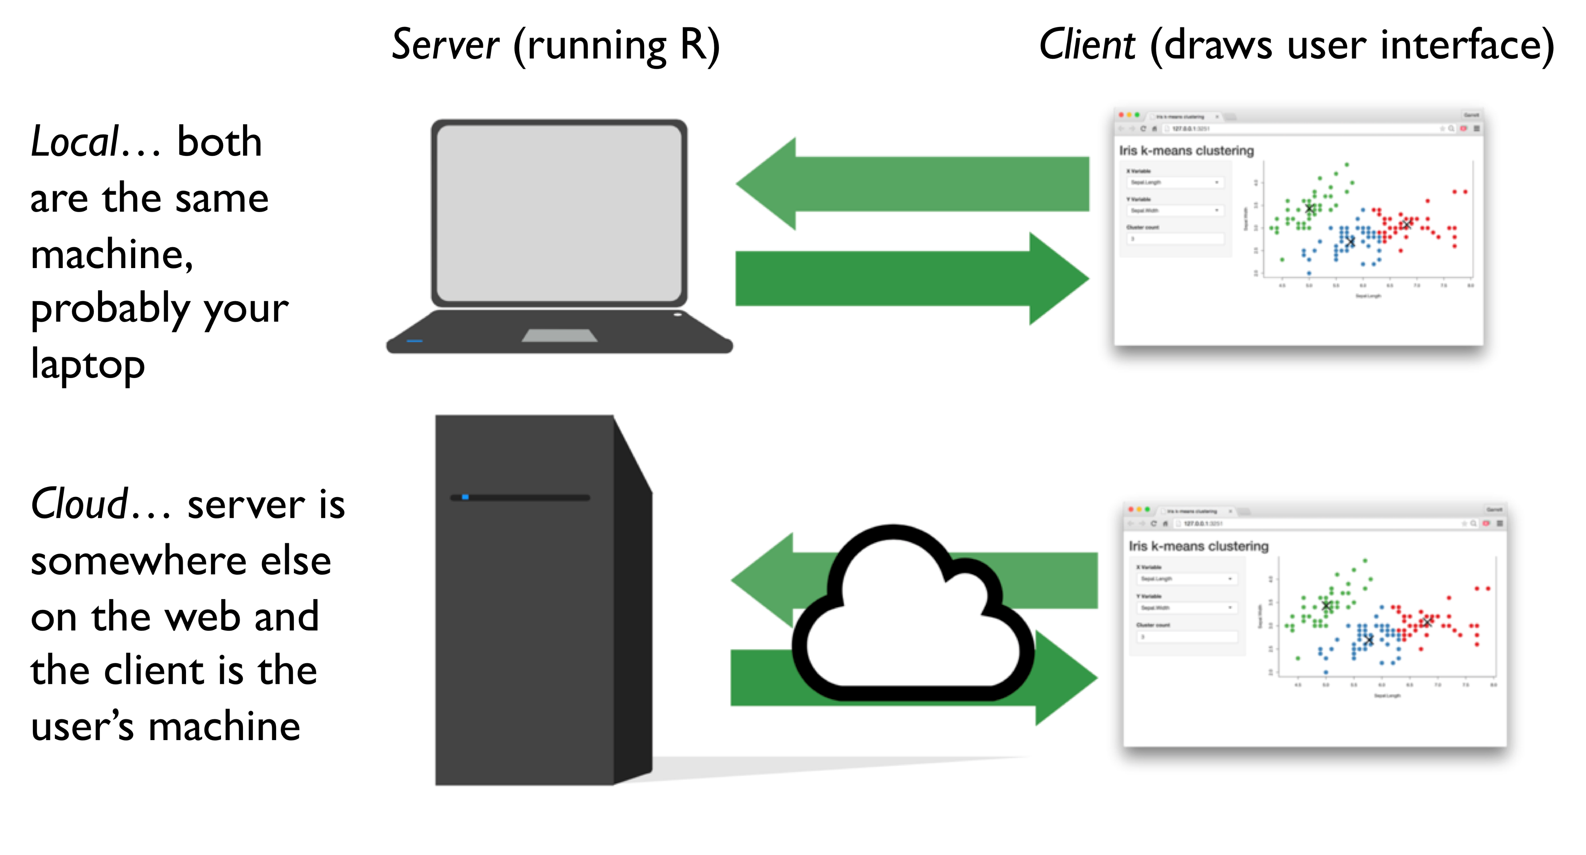
Whether to upload to the cloud?

Slide 33
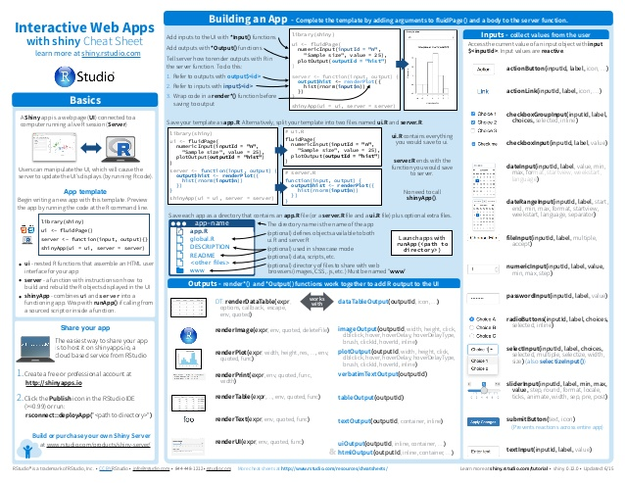

Further help …
https://blog.rstudio.com/2014/06/30/shiny-cheat-sheet/
http://darthworkgroup.com/

Slide 34


Shameless self promotion
R and Shiny for Health Economics?
https://www.sheffield.ac.uk/scharr/shortcourseunit/intror

Slide 35
Extra Slides

Slide 38
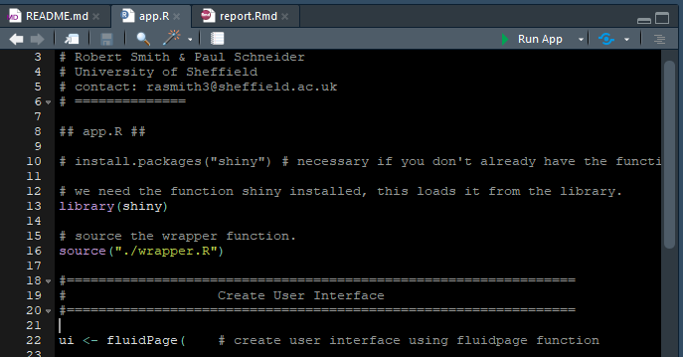

Slide 39
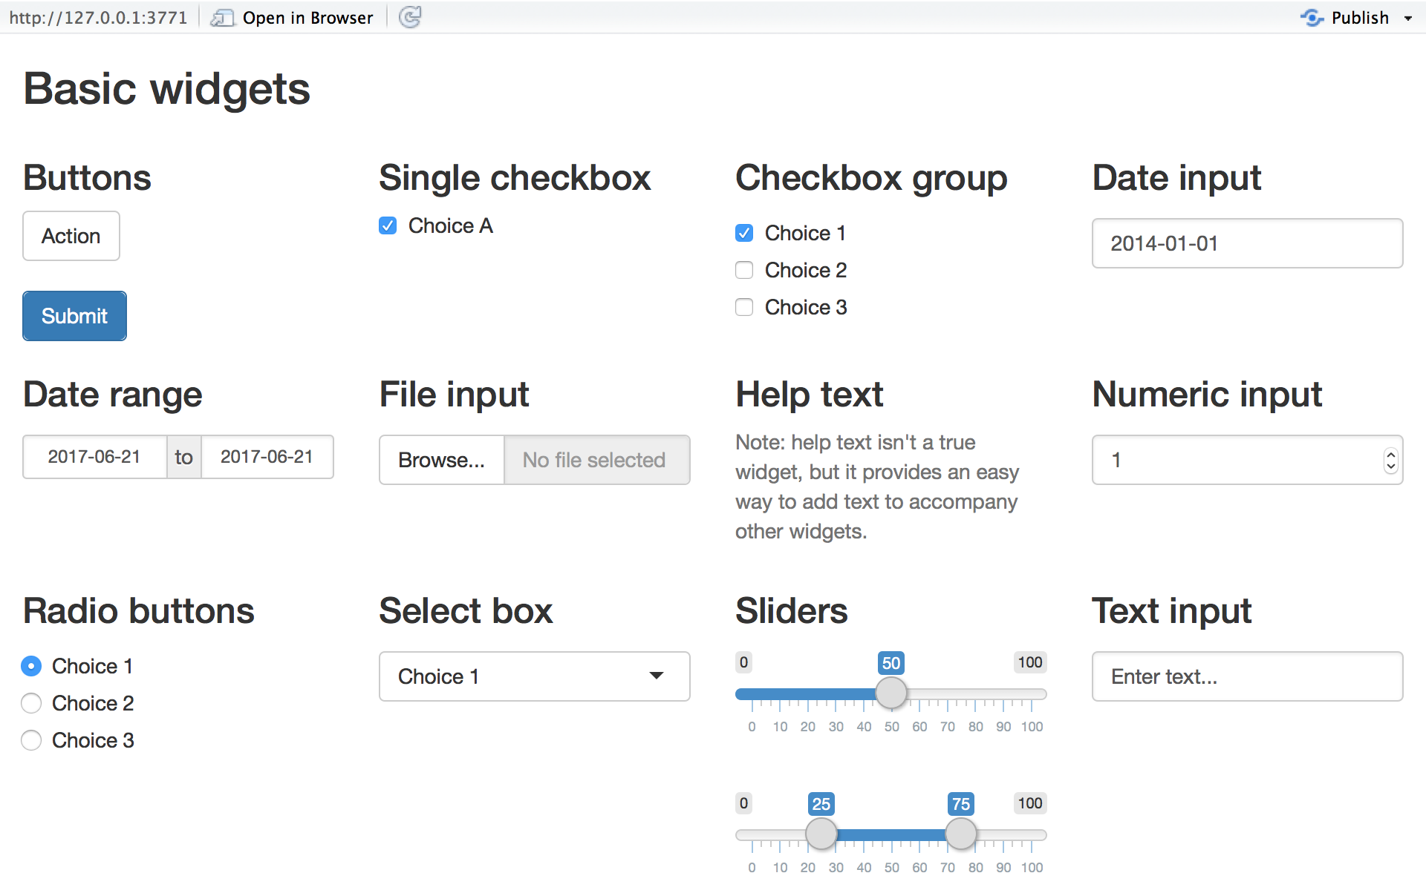
Inputs

Slide 40

Outputs

Slide 41
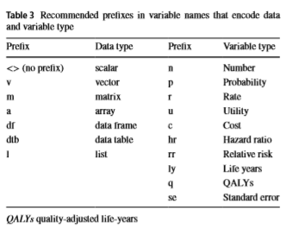
Coding framework
Alarid-Escudero, F., Krijkamp, E.M., Pechlivanoglou, P., Jalal, H., Kao, S.Y.Z., Yang, A. and Enns, E.A., 2019. A need for change! A coding framework for improving transparency in decision modeling. PharmacoEconomics, 37(11), pp.1329-1339.

Slide 42
Sourcing functions outside of wrapper
Inner function can call from global function and itself, not functions above.
environment(noac.net.benefit) <- environment() ~ specifies that the environment for this function is the same as the function that this line is within!!!

Slide 43
Run button
SERVER
UI
server <- function(input, output,) {
observeEvent(input$run_model, ignoreNULL = F, {
model_results = f_model_wrapper(input1 = input$slider1)
} # close observe event
} # close server function
ui <- dashboardPage(
…
actionButton("run_model","Run / update model")
…
)

Slide 44

Visualization functions
Plotting the CE-Plane & CEAC

Slide 45
Plot visualizations
SERVER
UI
output$CE_plane <- renderPlot({
plot_cep( model_output = model_res()$model.outputs)
})
tabPanel("CE Plane",
plotOutput("CE_plane",height = 450),
fluidPage(downloadButton('cep')))

Slide 46
plot_cep function
plot_cep <- function(model_output) ){
<insert code to get results into right format, incremental costs in long format vs comparitor>
ce_plane_plot = ggplot() +
geom_point(data= incr_long, aes(x=incr_Q, y=incr_C, col=Treatment)) +
geom_vline(xintercept = 0) +
geom_hline(yintercept = 0) +
theme_minimal() +
labs(title = "Cost-effectiveness Plane",
subtitle = paste0("Results of Probabilistic Sensitivity Analysis:")) +
# labels
xlab("Incremental QALYs") +
ylab("Incremental Costs (GBP)")
return(ce_plane_plot)
}

Slide 47
Download plot functionality
SERVER
UI
ceP_download <- plot_ce.plane.plot(model_output = model_res()$model.outputs)
output$cep = downloadHandler(
filename = 'ce_plane.png',
content = function(file) {
device <- function(..., width, height) {
grDevices::png(..., width = width, height = height,
res = 300, units = "in")
}
ggsave(file,
plot = ceP_download,
device = device)
})
tabPanel("CE Plane",
plotOutput("CE_plane",height = 450),
fluidPage(downloadButton('cep')))

Slide 48
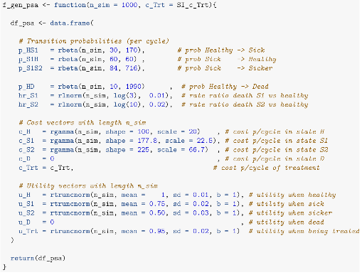
DARTH Sick-Sicker Model

Slide 49
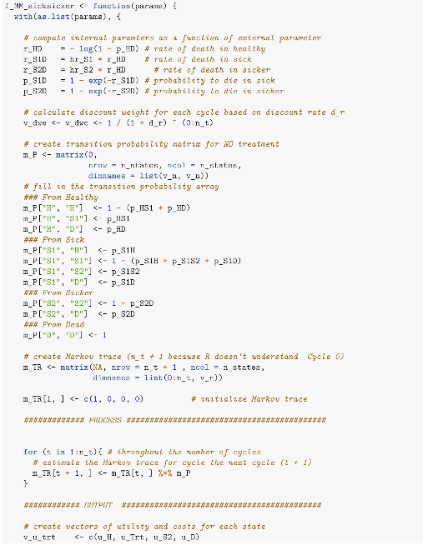
DARTH Sick-Sicker Model

Slide 50
Basic code for model wrapper
f_wrapper =
function(input1 = x,input2 = y, input3 = z){
< insert model code reliant on input 1-3 >
return(results) # return model results
} # close function bracket

Slide 51
Basic code for app
SERVER
UI
server <- function(input, output,) {
model_results = f_model_wrapper(input1 = input$slider1)
output$icer_table <- renderDataTable({
< ggplot results table code or function>
})
}
ui <- dashboardPage(
sliderInput(inputId = “slider1", label = “input1")
dataTableOutput("icer_table")
)

Slide 52
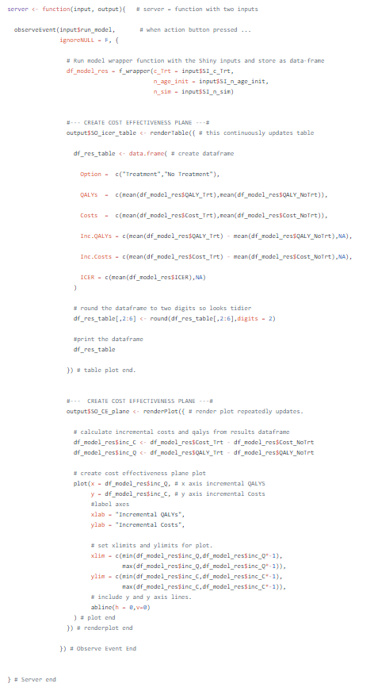
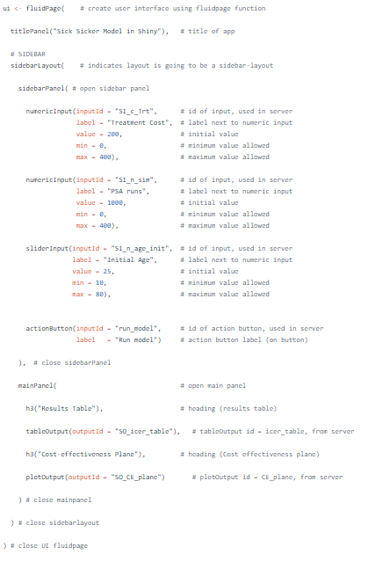
User Interface
Server
https://github.com/RobertASmith/healthecon_shiny/blob/master/App/app.R

Slide 53

Making the app run
But only when you want it to….

Slide 54
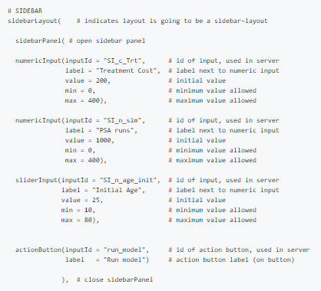
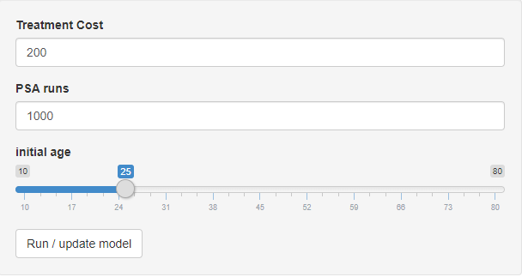
Making the run button

